Slide 1
How and When to Submit a Prospect Development Ticket
Last updated 4/13/2026 by Sara Gottschalk

Slide 2
Landing Page Overview

Slide 3
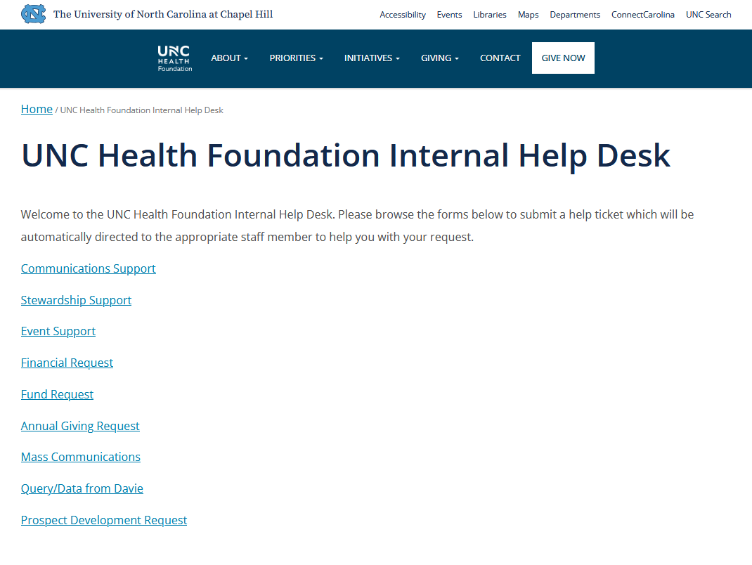
To access the form, visit our Internal Help Desk and select "Prospect Development Request" OR go directly to this URL: https://unchealthfoundation.org/help-desk-prospect-development-request/
NOTE: Select Query/Data from Davie for any data or lists that do not require patient information or additional research
Please do not include any PHI or sensitive information in your submission as our ticketing system is not a secured area.
  This includes uploaded attachments to your ticket
If your ticket requires an explanation with specific PHI please email a (Secure) message to the Prospect Development Team member responsible for your ticket type
  Data Analytics: used to request data visualization reports from Brianna
  Prospect Query List: used to request any data set in Davie that includes patient data, run by Abby
  Prospect Research: used to request any research from Sara that does not first require a list to be pulled from Davie
  Portfolio Management: used to request any changes to be made to your portfolio in Davie, which will be done by Chris
Start Here for Data Analytics, Patient Prospect Lists, Prospect Research, or Portfolio Management Requests

Slide 4
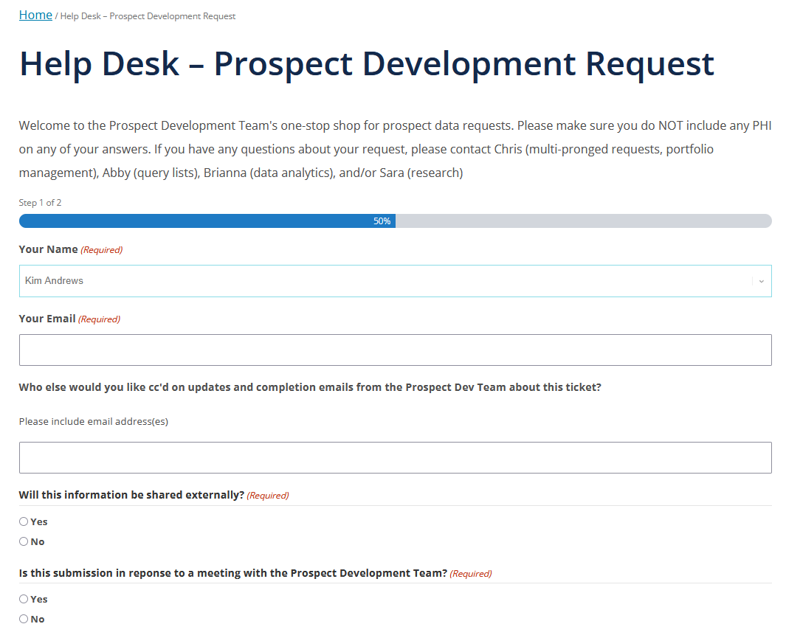
Our landing page asks overarching questions about your ticket that will help us understand your request
Your Name: Select your name, this will be our main point of contact for questions about the ticket or to send information about the finished project
Your Email: Type in the email that you would like us to use for you to receive communication about the ticket
Who else would you like cc’d…: Use this field if you have partners on the project that you would like communication to be shared with. You may type in multiple emails
Will this information be shared externally? Will let us know how to best structure our finished product
…Meeting with the Prospect Development Team? Have you already met with one of the PD Team members to discuss this ticket? Meetings are not required to submit a ticket but particularly encouraged before submitting a multi-pronged request

Slide 5
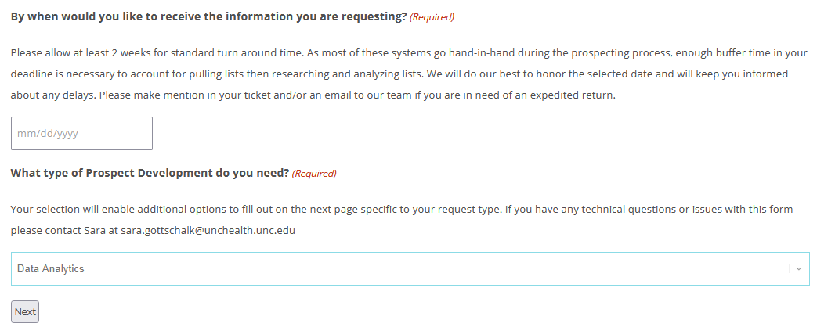
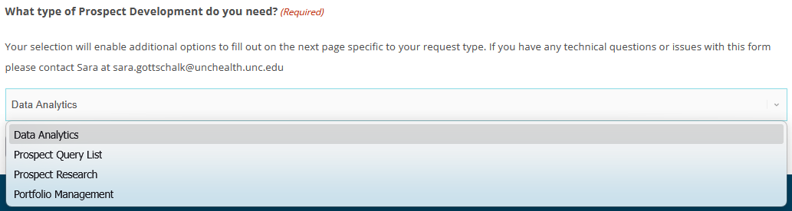
By when would you like to receive the information you are requesting? This is the deadline for when you would like to get the project back. Please note:
  Deadlines unless previously discussed with the PD team are considered as EOD of the date requested
  Often times tickets will go through multiple team members on their way to the finish line so please allow a standard of 2 weeks turnaround time of when you submit the ticket to the deadline date
  If your ticket is needed for a meeting, kindly add in buffer time of at least a few business days between the deadline and the meeting to allow for potential discussion time
What type of Prospect Development do you need? Your answer will change the next page
  Data Analytics: used to request data visualization reports from Brianna
  Prospect Query List: used to request any data set in Davie that includes patient data, run by Abby
  Prospect Research: used to request any research from Sara that does not first require a list to be pulled from Davie
  Portfolio Management: used to request any changes to be made to your portfolio in Davie, which will be done by Chris

Slide 6
Data Analytics Option

Slide 7
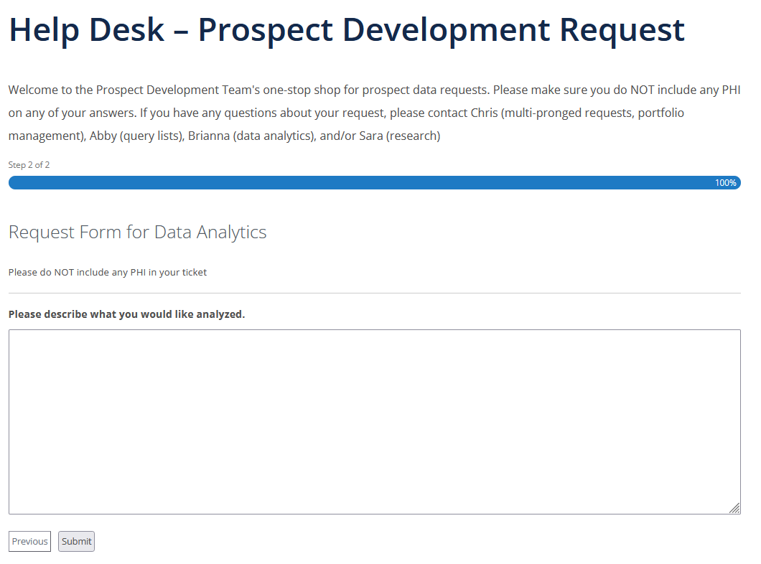
Data Analytics: used to request data visualization reports from Brianna
Please describe what you would like analyzed. Type your request into the word box, including necessary information about the data you would like reported on. Do not include any PHI here
Select Submit to send your request to Brianna (with Chris cc’d). She will be in touch with any questions and/or information about project completion

Slide 8
Prospect Query List Option

Slide 9
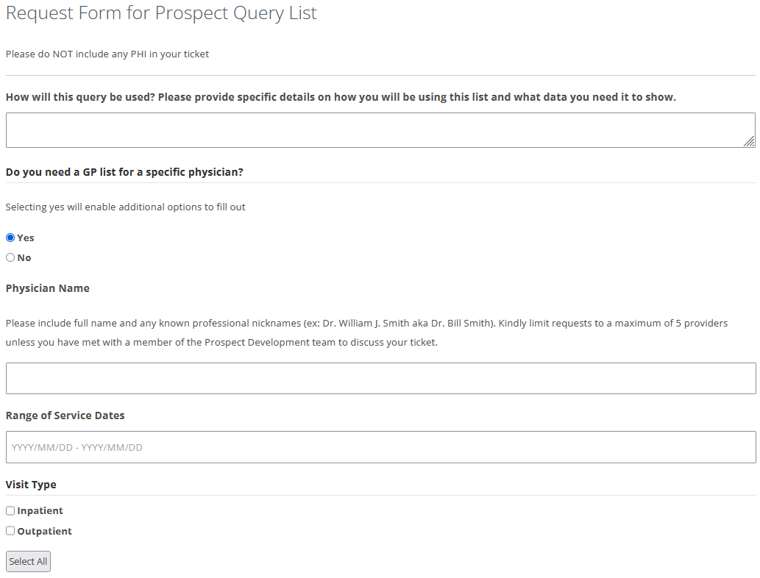
Prospect Query List: used to request any data set in Davie that includes patient data, run by Abby
How will this query be used? Please provide details about how this query will be used in order for us to better our understanding of what information you will need. Do not include any PHI.
  If you need to include PHI, please submit your ticket without and then send an email to Abby and Chris using a (secure) with the PHI information referencing your ticket number received via your ticket confirmational email
Do you need a GP list for a specific physician? Selecting Yes will enable two additional questions to answer; choose based on what you want the list to include:
  Range of Service Dates –The list will include number of visits to the provider in the timeframe requested
  Visit Type – multi-select, choose any that you want included in the list. Note that the list is run on visit start dates in the dates requested above

Slide 10
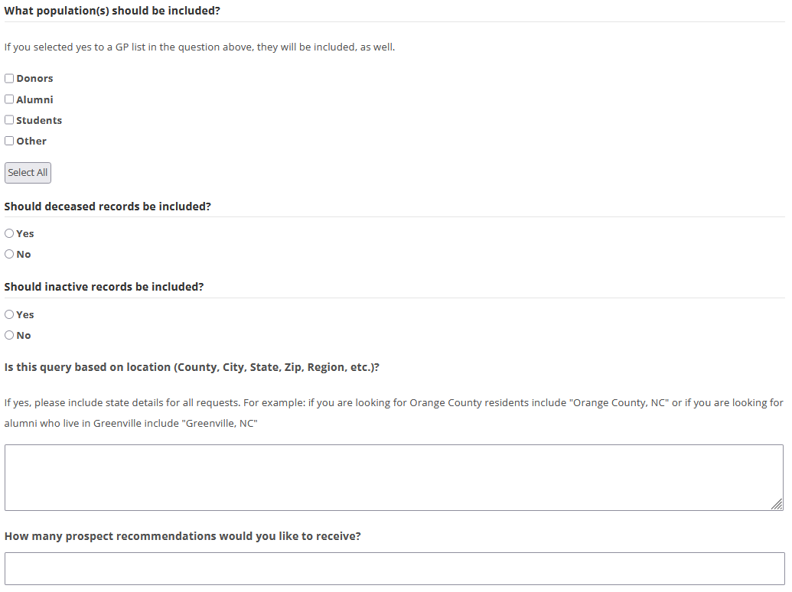
What populations should be included? Selecting Other will enable a text box to identify which population you need not listed. You should select Yes to the aforementioned GP list question to include a patient population in your list
Should inactive records be included? Note that sometimes inactive records include merged hidden patient data of a duplicate record. In the merge process, the inactive record becomes the primary record without the inactive/active status changing
Is query based on location? Please be as specific as possible here so that we can include the correct information in the list without (wrongly) assuming what you meant
How many prospect recommendations would you like to receive? This should be used to indicate you would like to receive a shortened prospect recommendation list rather than a full prospect/patient list. This number will be used as a goalpost for recommendations, based on what the data & research reflects

Slide 11
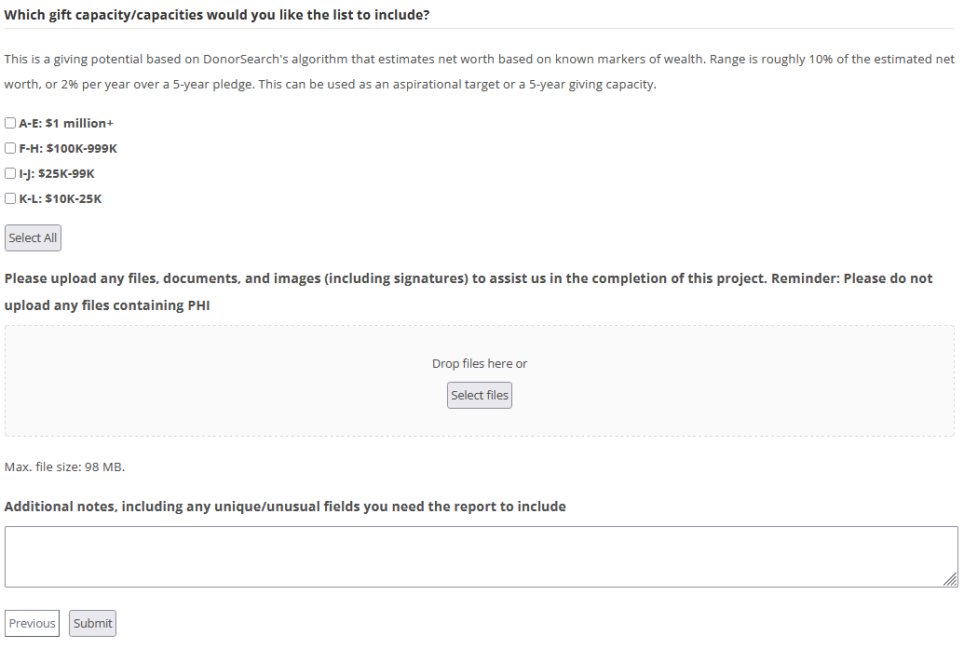
Which gift capacity would you like the list to include? Select based on whether you are specifically looking to limit your list using capacity estimates made by DonorSearch. Otherwise, the list will include all prospects regardless of capacity. Typically a researched list will only include prospects with estimated high capacity ($100k+) and inferred high interest
Please upload… & Additional notes - these, along with all other questions on the form, should not include any PHI whatsoever
Additional Notes – a standard researched report will include:
  Research Notes
  PID
  Prospect Name
  Requested provider information including name of provider, count of visits within timeframe, most recent visit to provider, that visit type (inpatient/outpatient)
  DS Wealth-Based and Estimated capacities
  Age and date of birth
  Basic contact info: phone, email, primary address
  Giving info: Last gift date, total gift amount, # of gifts, largest gift amount, largest gift date, last gift amount, first gift date, and first gift amount
Select Submit to send your request to Abby (with Chris cc’d). She will be in touch with any questions and/or information about project completion

Slide 12
Prospect Research Option

Slide 13
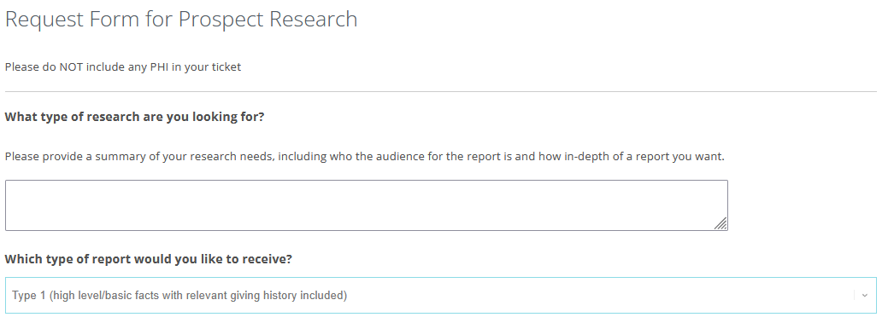
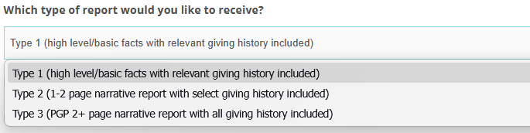
Prospect Research: used to request any research from Sara that does not first require a list to be pulled from Davie
What type of research are you looking for? Please provide a non-PHI summary of your research needs that would inform your selection for type of report, for example:
  A type 1 request is a specific question like “I met with donor so-and-so, they mentioned that they just sold their company but did not disclose for how much. Can you find an amount?”
  A type 2 might be, “I have a meeting with donor so-and-so on August 2, I would like to know a little bit of their background and specific healthcare giving history to see what designation options I could proactively prepare for the meeting”
  A type 3 might be, “I am meeting with a donor who indicated they would be willing to give $1mil to Medical Alumni Loyalty Fund. Can you provide me with a full narrative on who they and their family are, what connections they have with UNC/UNCH, and any other philanthropy they’ve done to see if $1mil is a minimum or a maximum?”

Slide 14
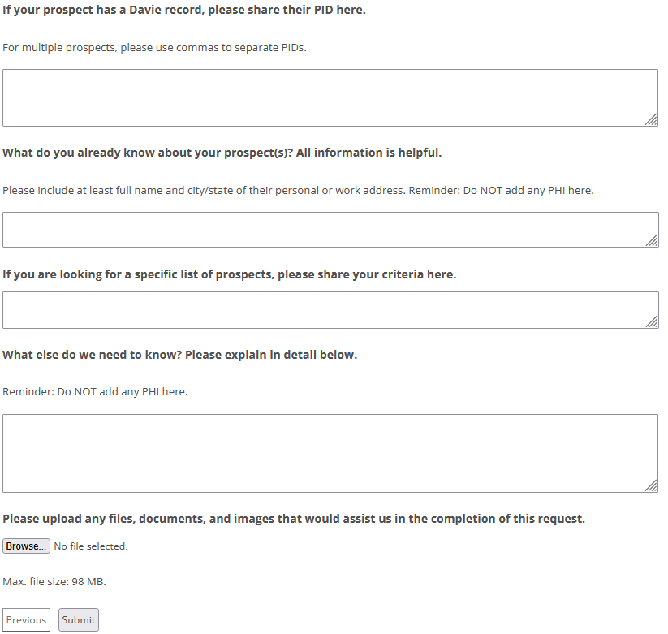
If your prospect has a Davie record, please share their PID here. This is vital to ensure correct prospect research, for instance, we may have a John Smith I, John Smith II, and John Smith III all living in Raleigh with John I and John II married to a Sue and a Susan. Without a PID, we cannot immediately determine which prospect you would like researched
What do you already know about your prospect? This is especially helpful for those prospects who are not already in Davie, for the same reason as above. Additionally, information garnered from your discovery work will help enhance a narrative report
If you are looking for a specific list does not apply to patient/population lists. For those use the prospect query option. This should be used to ask for highly targeted list of prospects that you may not be able to easily find in Davie like “a list of Johnson & Johnson’s board with connections to UNC or UNCH”
Please upload… & What else do we need to know - these, along with all other questions on the form, should not include any PHI whatsoever
Select Submit to send your request to Sara (with Chris cc’d). She will be in touch with any questions and/or information about project completion

Slide 15
Portfolio Management Option

Slide 16
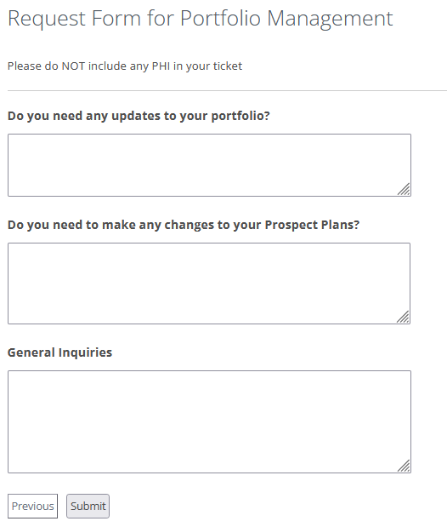
Portfolio Management: used to request any changes to be made to your portfolio in Davie, which will be done by Chris
Do you need any updates to your portfolio?
Do you need to make any changes to your Prospect Plans?
General Inquiries
Select Submit to send your request to Chris. He will be in touch with any questions and/or information about project completion

